Slide 1



“The TIF Illumination Project”
June 2024 Tom Tresser

Slide 2
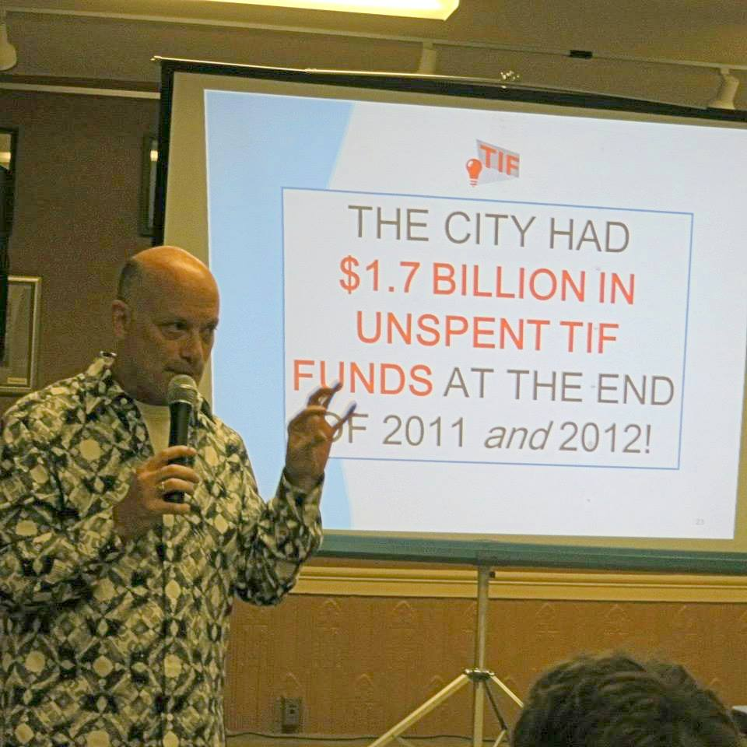
Tom Tresser
tom@treser.com 312-804-3230

Slide 3
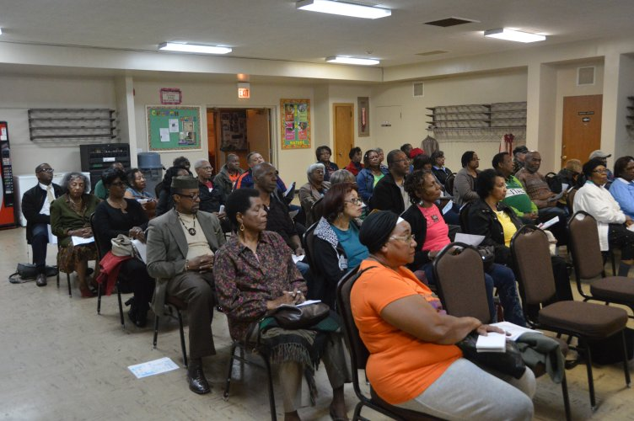

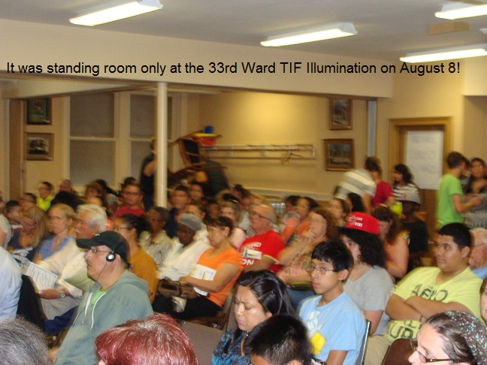
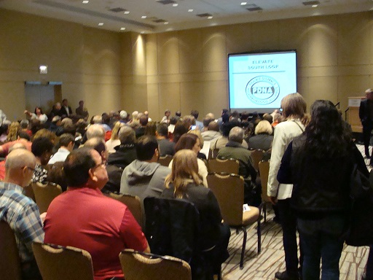
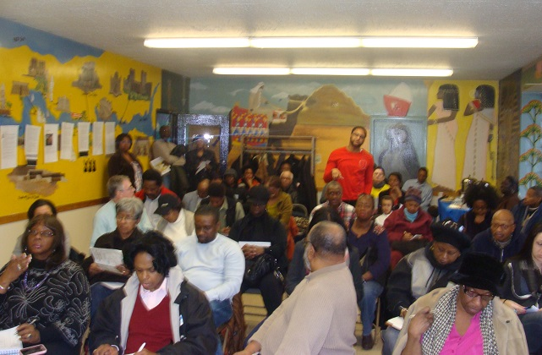
We’ve done 225+ public forums since Feb 2013!
21stWard
2nd Ward
20th Ward
33rd Ward
Notes:
http://www.tifreports.com/tif-organizing-services

Slide 4

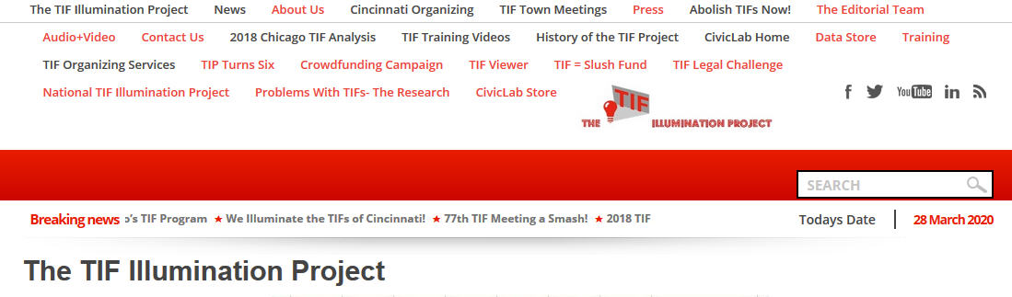
The TIF Illumination Project
Go to www.tifreports.com for video primer and other background info on how TIFs work…
290,000 people Illuminated since 2013!
Notes:
Check out http://www.tifreports.com

Slide 5
What are TIFs?
Tax Increment Financing Districts
Created by municipality (IL state law)
Designed to subsidize some business project in “blighted” or under-served area
“But for” test – only for projects market CAN NOT support
Captures “incremental” property taxes ABOVE base when district was created
Only for hard costs
Lasts 23 years
Supposed to be spent where collected
Property taxes!

Slide 6
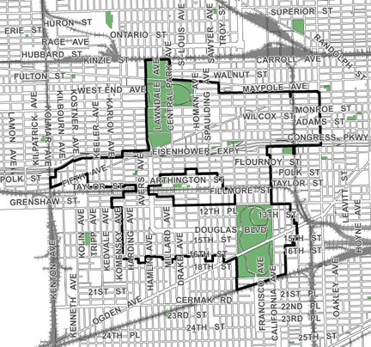
What are TIFs?
Say there are 1,000 properties in this TIF…
…then this $1,000 is called the “Base.”
…and say that these properties are generating $1,000 in property taxes as the TIF starts…
The Midwest TIF – 24th Ward (created in 2000)

Slide 7
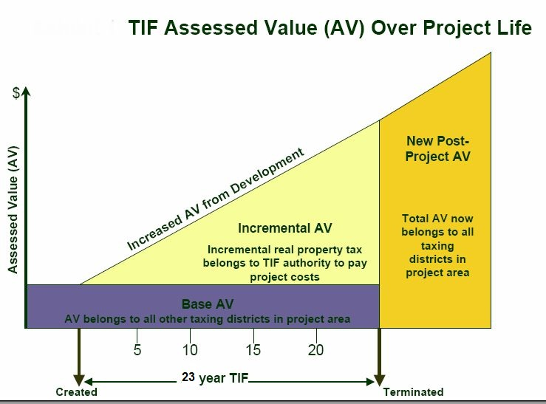
How Do TIFs Work?
When the TIF is created, the city tallies up all the property taxes generated by district in that year (called the "base" amount). After that, all property tax increases above the base (the "increment") are channeled to the TIF district.
The property taxes collected from properties inside the district BEFORE the district was created that go to units of government stays FLAT for the life of the TIF (23 years).
$1,000 from example

Slide 8
How Do TIFs Work?
THIS MONEY GOES TO THE MAYOR.
IT IS “OFF THE BOOKS”
THIS MONEY IS USED FOR UNITS OF LOCAL GOVERNMENT. IT IS “ON THE BOOKS”
$1,000 from example

Slide 9
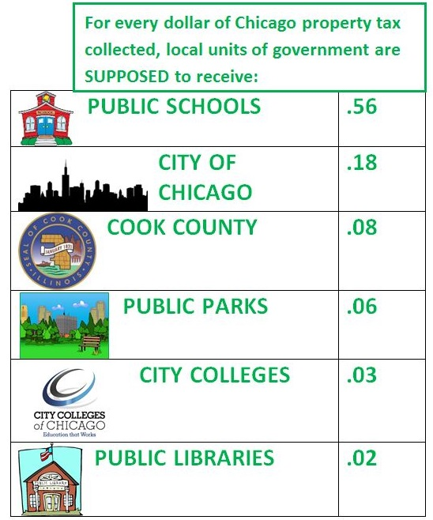
Money From TIFs Taken From?
The “Base”
$1,000 from example

Slide 10
What are TIFs?
Under state law, areas proposed for TIF designation must possess numerous blighting factors to be eligible:
Age
Obsolescence
Code violations
Excessive vacancies
Overcrowding of facilities

Slide 11
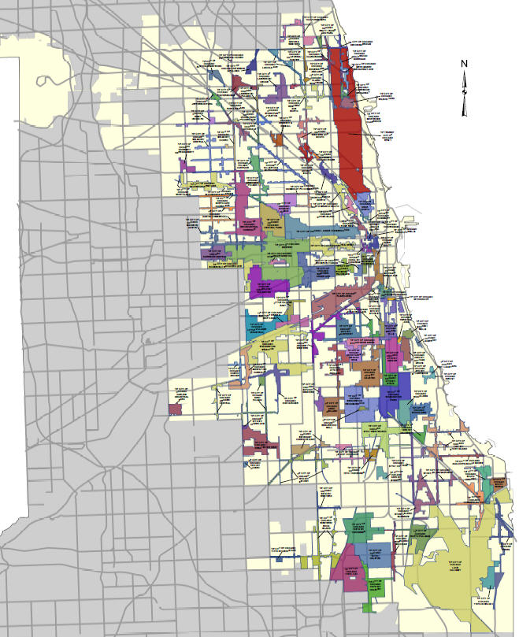
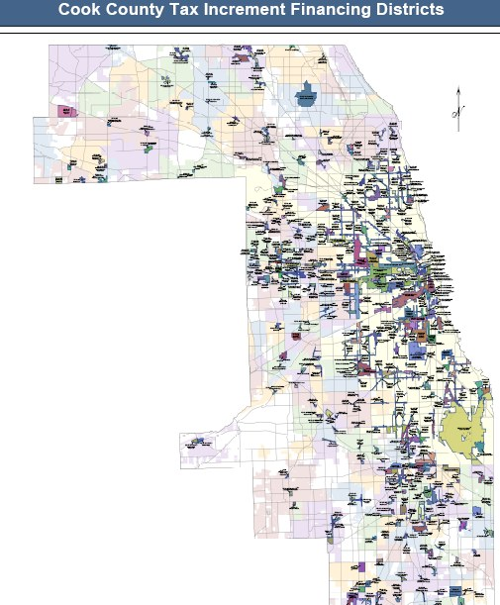
Where are TIFs?
2022 Chicago = 131 Suburbs = 320
Cook County = 451
34% of ALL of Chicago is in
a TIF!
Notes:
Chicago: https://www.chicago.gov/city/en/depts/dcd/supp_info/tif-district-annual-reports-2004-present.html
Cook County: https://www.cookcountyclerkil.gov/property-taxes/tifs-tax-increment-financing/tif-reports

Slide 12
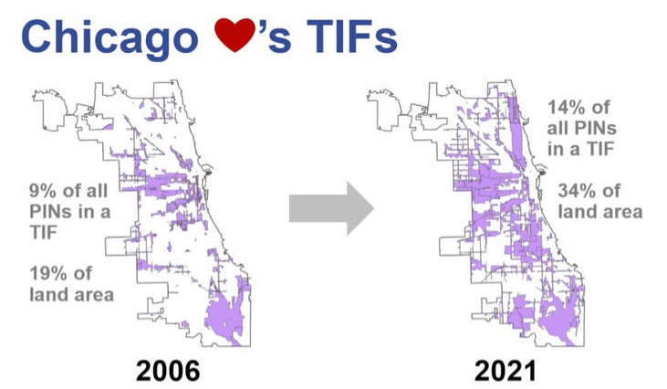
Where are TIFs?
Source: Cook County Assessor’s Office – 1/17/23 presentation

Slide 13

Chicago TIFs have
RUN AMOK!
131 active TIFs in 2022
$960 million removed in 2022
$362.4 million spent in 2022
$11.2 Billion removed since 1986

Slide 14
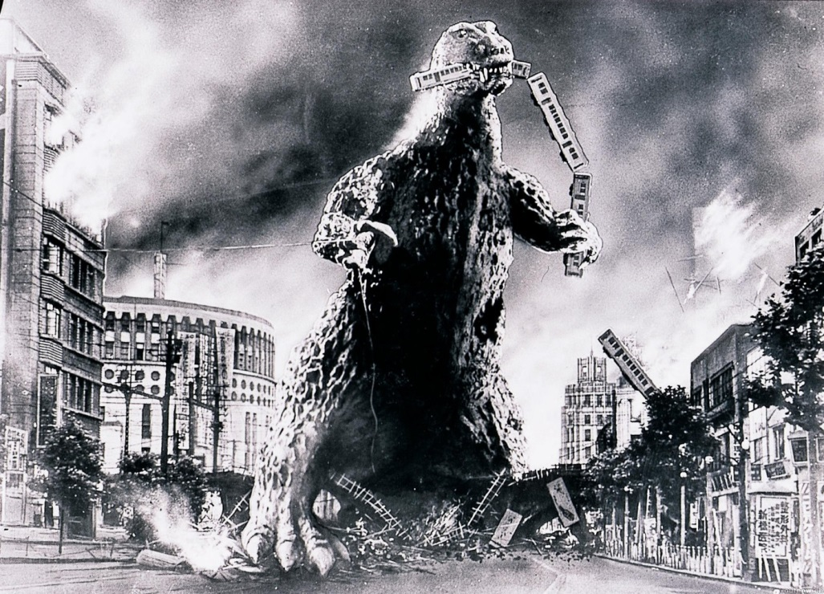

CHICAGO HAD $2.5 BILLION IN UNSPENT TIF FUNDS AT THE END OF 2022!
Mr. TIF

Slide 15
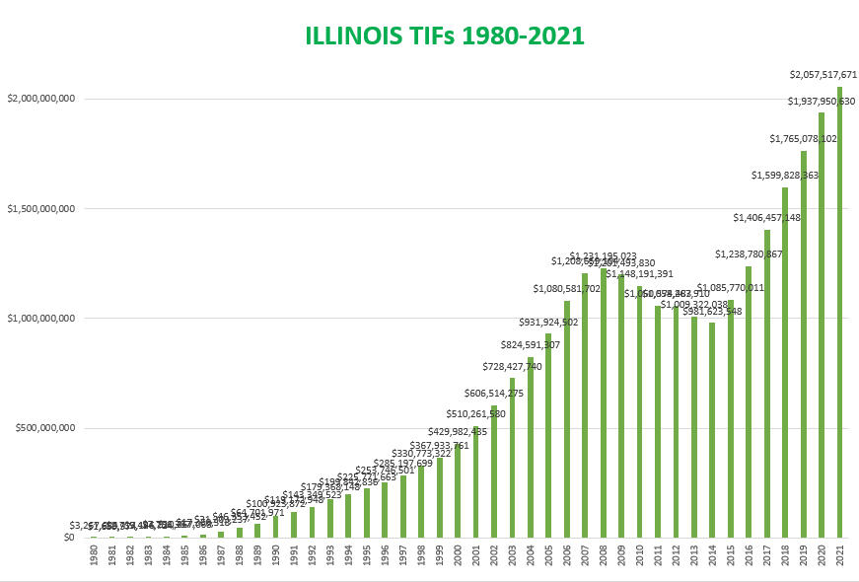
$27.5 BILLION TO DATE!
1,453 TIFs x 534 municipalities!
$2.06 BILLION REMOVED IN 2021
Notes:
https://dceo.illinois.gov/content/dam/soi/en/web/tax/research/taxstats/propertytaxstatistics/documents/y2021tbl14agraph.xlsx

Slide 16
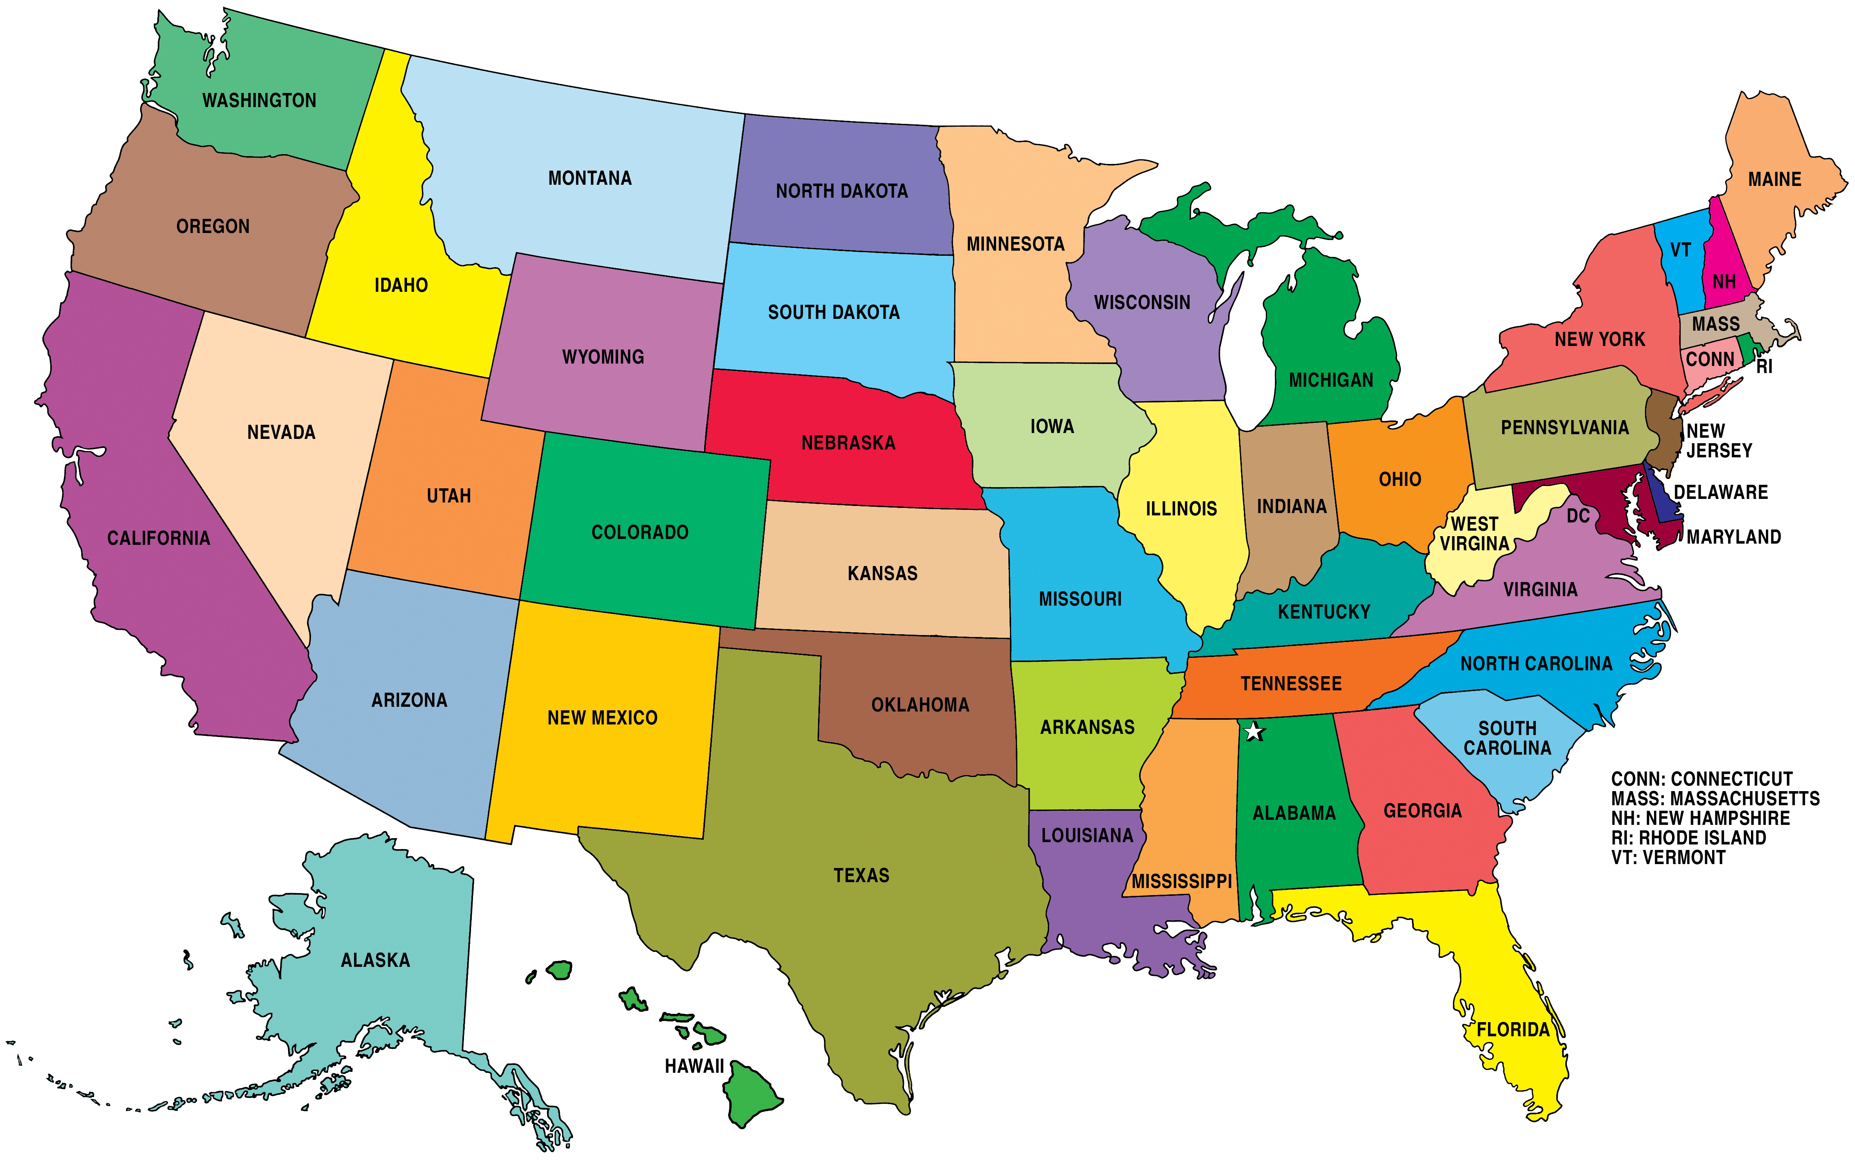

Estimated 40,000+ TIFs extract $40 BILLION/year!
Notes:
That’s $20 BILLION extracted, taken offline ANNUALLY, from US public education funding via property taxes!

Slide 17


Philip Yates Associate Professor, Mathematical Sciences & Statistics
pyates@depaul.edu
773-325-4216

Slide 18
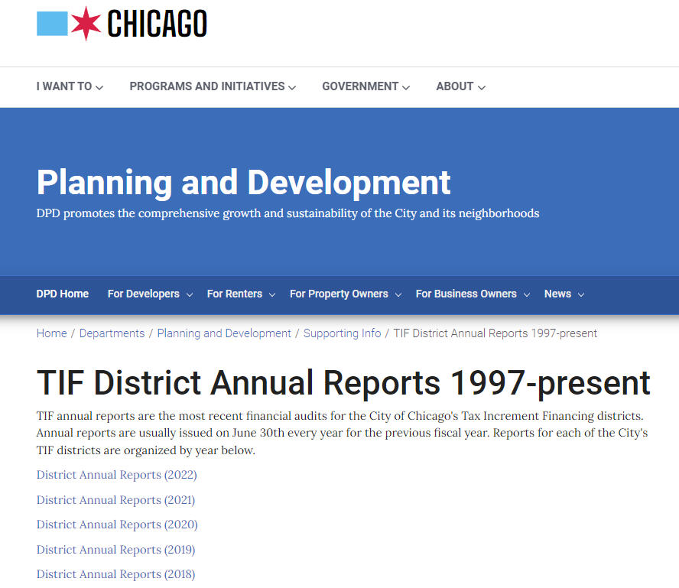
Notes:
Chicago TIF Annual Reports = https://www.chicago.gov/city/en/depts/dcd/supp_info/tif-district-annual-reports-2004-present.html

Slide 19
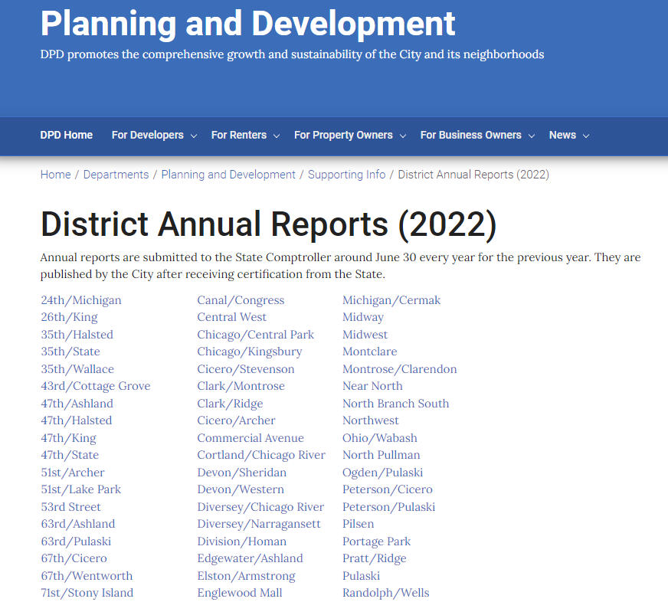

Slide 20
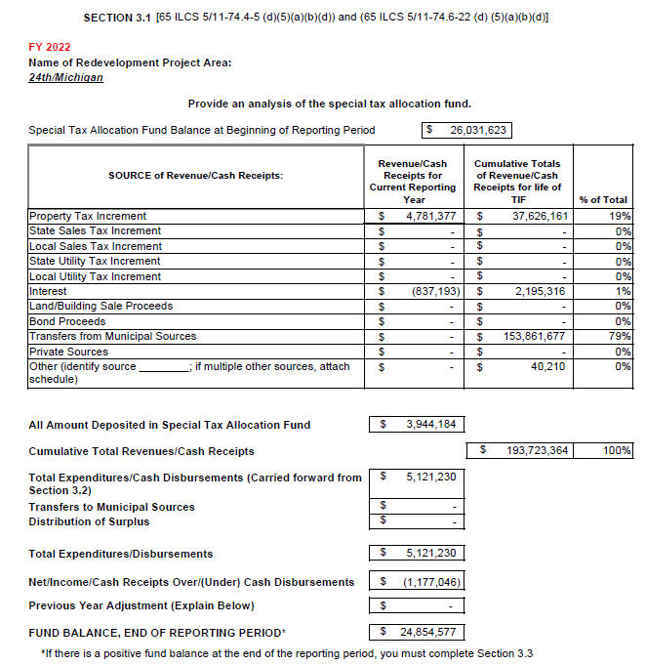

Slide 21
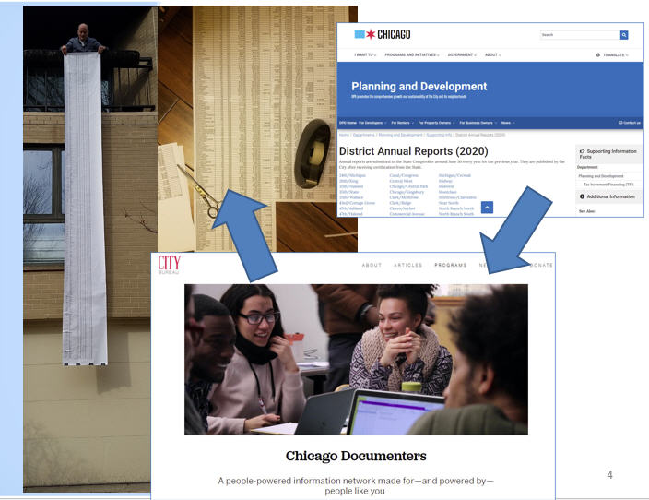
Manual data harvesting

Slide 22
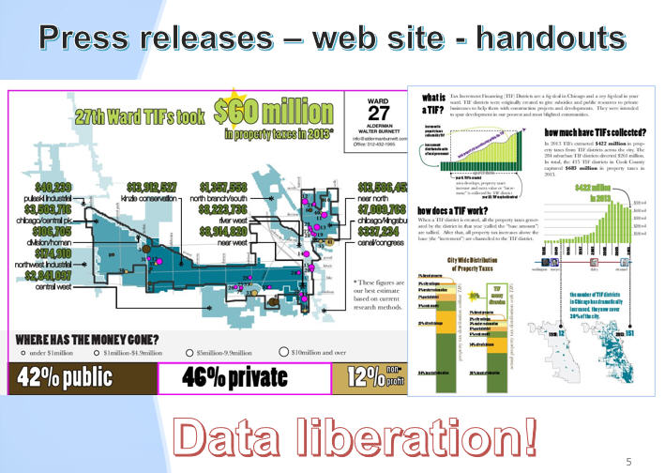

Slide 23
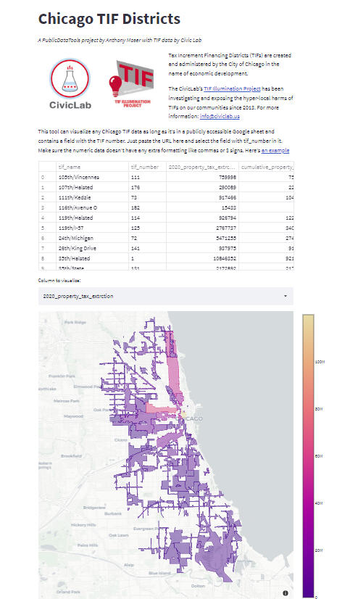
Notes:
https://chicagotifs.streamlit.app – Developed by Anthony Moser – https://www.linkedin.com/in/anthony-moser-4135b6119 – Data Activist and Musician! http://anthonymoser.com
ALSO:
- City of Chicago = https://webapps1.chicago.gov/ChicagoTif
- Cook County = https://maps.cookcountyil.gov/tifViewer
- Chicago Inspector General = https://informationportal.igchicago.org/chicago-tif-districts-fund-balances
- Chicago Cityscape = https://www.chicagocityscape.com/maps/index.php#/?places_type=tif&places_chicago=t;

Slide 24

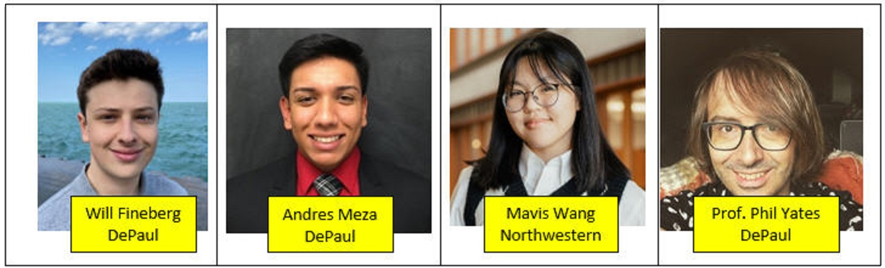

Slide 25
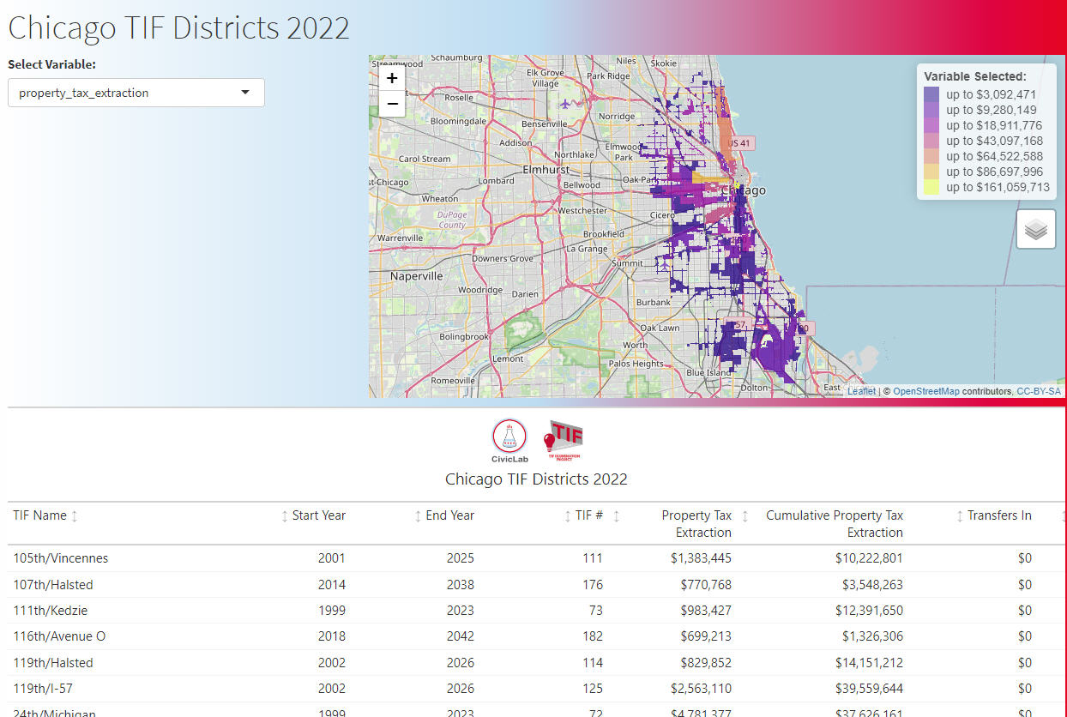
Notes:
ShinyApps = www.tinyurl.com/2022-Chicago-TIF-Viz

Slide 26
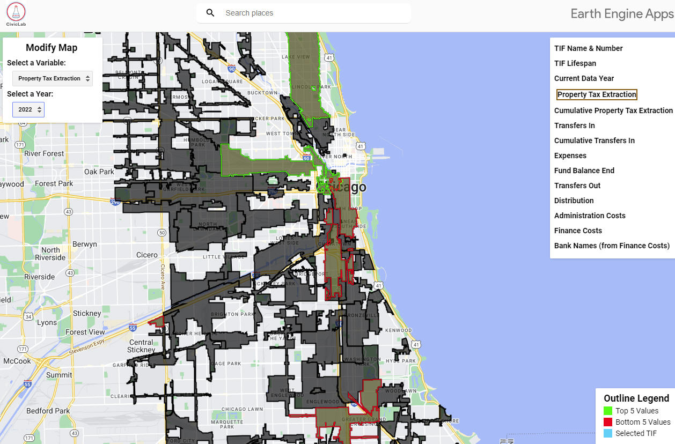
Notes:
Earth Engine = www.tinyurl.com/Chicago-TIF-Viz-2010-2022

Slide 27
https://github.com/philipayates/chicago2022TIF/tree/main
www.tinyurl.com/2022-Chicago-TIF-Viz
www.tinyurl.com/Chicago-TIF-Viz-2010-2022
https://tifreports.com/2022-tif/2022-tif-briefing
Notes:
ShinyApps = www.tinyurl.com/2022-Chicago-TIF-Viz

Slide 28
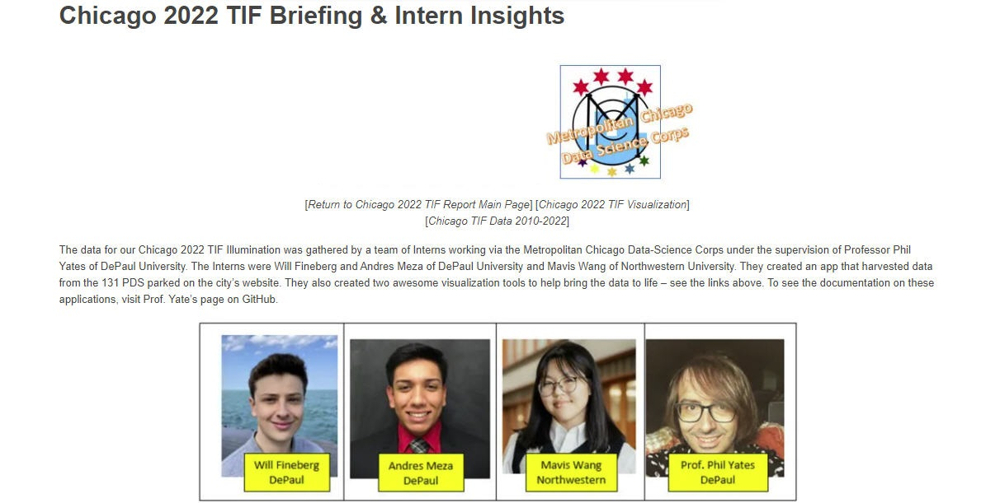

Notes:
https://tifreports.com/2022-tif/2022-tif-briefing

Slide 29


